Slide 1
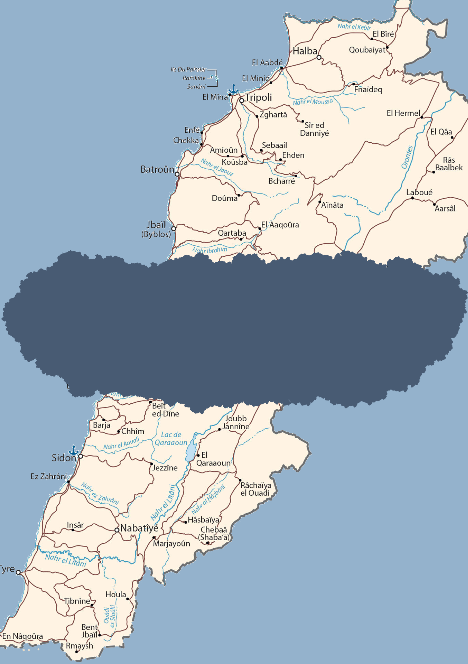
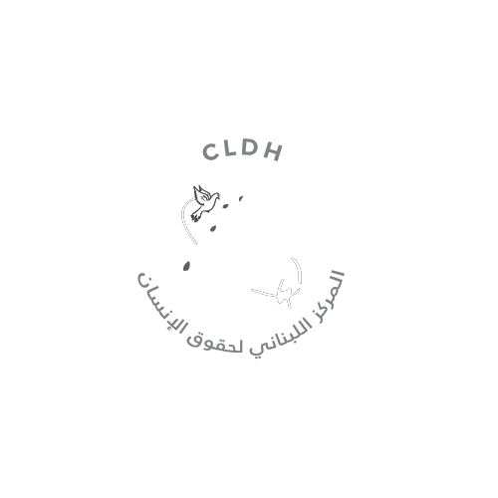
HUMAN RIGHTS DEVELOPMENTS IN A WEEK
16 June - 22 June 2025
SOURCE: LEBANON MAP

Slide 2
Human Rights are inherent to all human beings, regardless of the nationality, place of residence, sex, national or ethnic origin, color, religion, language or any other status without discrimination. These rights are all universal, inalienable, interrelated, interdependent and indivisible.
The articles shared in this brief are the liability of their respective news outlets and do not reflect the views of CLDH.
LEBANON
Israeli airstrikes hit border areas
Israeli airstrikes targeted Taybeh, Adaisseh, Awaida area , and al-Qadam neighborhood of Houla on Monday, June 16. Israeli forces also conducted a combing operation on the outskirts of Aitaroun at night.
Israeli forces return a shepherd after kidnapping him in Kfarshouba
Shepherd Mohammad Ghanem was released by Israeli forces an hour after detaining him in Ruwaysat al-Alam site in Kfarshouba that an infantry advanced to on Tuesday, June 17.
Simultaneously, Israeli forces threatened fishermen in Tyre and Naqoura ports through leaflets it dropped this morning, and other members fired machine gun bursts toward the outskirts of Aitaroun.
One citizen killed on an Israeli airstrike on Barish
An Israeli airstrike targeted a motorcycle in Barish and injured one citizen on Wednesday, June 18.
In the same area, an Israeli interceptor missile fell in a valley between the towns of Barish and Ma'roub.
Israeli drones drop leaflets with fake money over Aitaroun
In the morning hours, an Israeli drone dropped leaflets in the form of counterfeit dollars over Aitaroun on Wednesday, June 18. The leaflets included slogans which included: "don't miscalculate the money."
Monday
16 June 2025
Tuesday
17 June 2025
Wednesday
18 June 2025

Slide 3
Thursday
19 June 2025
Two killed in Israeli airstrike on Kfarjouz
Israeli airstrike targeted a motorcycle in Kfarjouz, Nabatieh district, killing two citizens on Thursday, June 19.
Simultaneously, Israel threw incendiary bombs on Al-Mahafer area and three more between Aitaroun and Blida and no injuries were recorded.
One killed in Israeli airstrike on Abbassieh
One citizen was killed in an Israeli airstrike on a car in Abbassieh, Tyre district on Friday, June 20.
Simultaneously, a parked car in Hebbariyeh was targeted with an Israeli airstrike and no injuries were recorded. Israeli forces also bombed two houses in Houla and Mays al-Jabal at dawn.
Lebanese Army inspects minefield and removes earthen embankment in Mays al-Jabal
Statement issued by the The Army Command - Directorate of Orientation on Friday, June 20:
As part of its efforts to monitor the situation in the south and eliminate Israeli violations, an army unit, in coordination with the United Nations Interim Force in Lebanon (UNIFIL), conducted an engineering survey of a minefield in the outskirts of the town of Mays al-Jabal - Marjayoun. The survey also removed an earthen embankment and engineering obstacles previously placed by the enemy.
UNIFIL patrol prevented from movement in Sultaniyeh
According to the National News Agency, residents from Sultaniyeh village in Bint Jbeil intercepted a UNIFIL patrol and blocked the patrol’s movement to Wadi al-Sultaniyeh since it was not escorted by the Lebanese Army on Saturday, June 21.
Lebanese Army recovers bulldozer stolen by Israeli forces
The Lebanese army recovered a bulldozer that was stolen by Israeli forces in the Karkazan neighborhood of Mays al-Jabal on Saturday, June 21.
The Israeli forces had seized the bulldozer on Friday before moving it back into Lebanese territories on Saturday night, and managed to build a trench and a large earthen barrier around the bulldozer.
Israeli airstrike on broadcasting building of Al-Manar
Israeli drones attacked Al-Manar TV’s broadcasting building located on the hills of Toumat Niha, Jezzine in the early morning hours of Sunday, 22 June.
In similar events, an Israeli airstrike bombed a house on the eastern outskirts of Aitaroun and another raided Adaisseh.
Friday
20 June 2025
Saturday and Sunday
21 and 22 June
2025

Slide 4
REPORTING A VIOLATION OF HUMAN RIGHTS TO CLDH
If you wish to report an incident that may potentially constitute a violation of human rights, kindly send an email to the following address: violations@cldh-lebanon.org
You can also report an incident anonymously through our website.
When making a report, please ensure to include the following information:
WHERE: City/village, governorate, additional details (e.g. what prison)
WHAT: Nature of the violation
HOW: A narrative description of what happened
WHEN: Date of the episode (at least the year, if day and month are unknown)
TO WHOM: Information regarding the victim (name, nationality, gender, date of birth, city of origin, phone number). Only share this information with the consent of the person.
WHO is the person reporting (name, phone number) and how were they identified (e.g., victim him/herself, family member, eyewitness, journalist, humanitarian worker...)
The information referred will remain completely private. It will be fact-checked and registered into CLDH’s internal system. No action will be undertaken without the explicit and written consent of the reporter.
FUNDED BY THE UNITED NATIONS DEMOCRACY FUND

